Slide 1
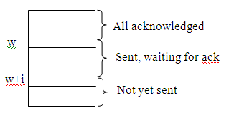
Sliding window protocols:
Window: subset of consecutive frames
only frames in window can be sent

Slide 2

Typical frame format:
If seq field is m bits then seq nos are between 0 and 2^{m}-1
Ack is the frame # being ack’d. this is a piggyback acknowledgment, providing an acknowledgment in a data frame.
Useful for full duplex communication
Type can be data/nak/ack

Slide 3
Go-Back-n sliding window protocol
Receiver expects frames to arrive in order.
Out-of-order or damaged frames discarded and a nak may be sent
Does not ack each frame explicitly. Uses piggyback (frame.ack field in a frame) or maybe a special ack timer to send separate ack.
Ack number means all frames up to that number are received OK.
Sender buffers frames in window

Slide 4
Frame timer (1 for each frame)
no ack arrives in a specified time
resend all frames in window
Rationale: 1st frame not ack’d ⇒ receiver probably ignored all others.

Slide 5
Window size: m-bit sequence field ⇒ size ≤ 2^{m} (to avoid duplicate nos).

Slide 6
Possible failure if size = 2^{m}
Sender sends 0-7
receiver gets 0-7 and acks 7
ack gets lost
sender resends 0-7
Since receiver is expecting 0 resent frames accepted as new.

Slide 7
If size = 2^{m}-1
Sender sends 0-6
receiver gets 0-6 and acks 6
ack gets lost
sender resends 0-6
Since receiver is expecting 7 resent frames are rejected.

Slide 8

Note
In Go-Back-N ARQ, the size of the send window must be less than 2^{m};
the size of the receiver window is always 1.

Slide 9
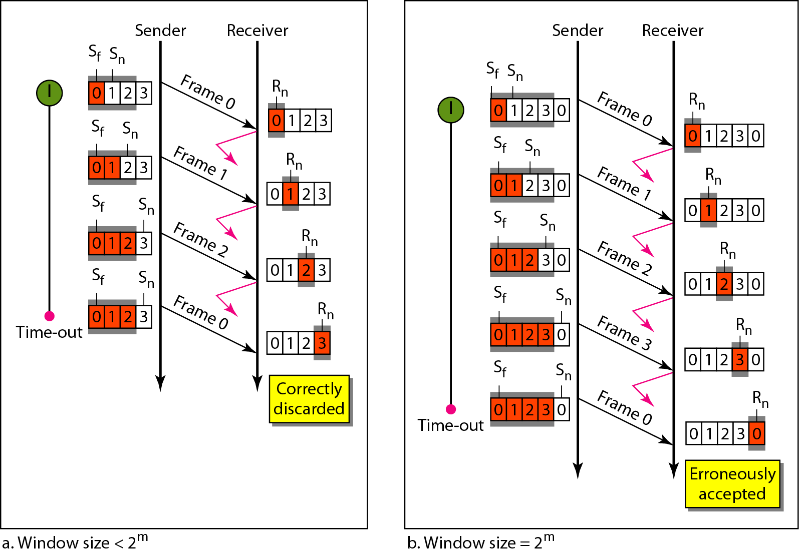
Figure 11.15 Window size for Go-Back-N ARQ

Slide 10
Algorithm 11.8 Go-Back-N receiver algorithm
If corrupted, could also send a NAK so sender does not have to wait for a timer to expire

Slide 11
Algorithm 11.7 Go-Back-N sender algorithm
(continued)

Slide 12
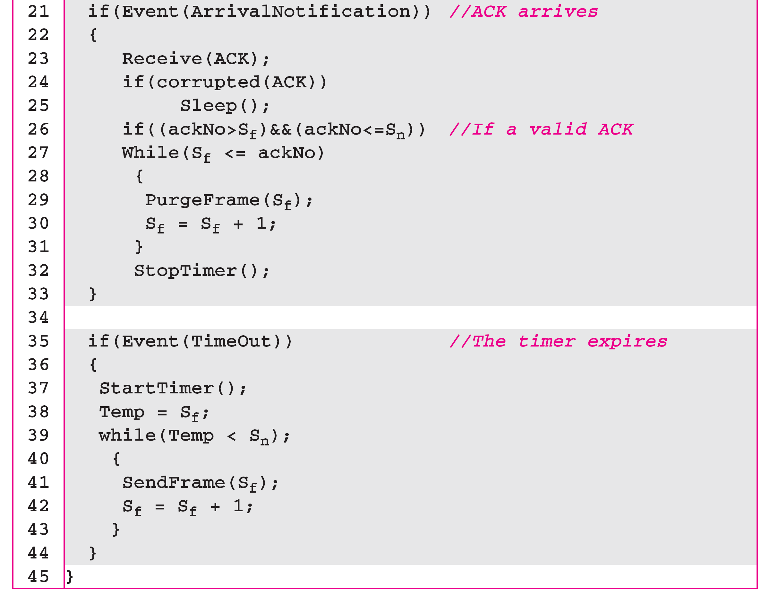
Algorithm 11.7 Go-Back-N sender algorithm
(continued)
If corrupted, could also resend all frames in the window

Slide 13
Do some examples:
Data frame lost or delayed
Ack frame lost or delayed
Data frame damaged.
ALWAYS error check each frame and at least ignore bad frames.

Slide 14
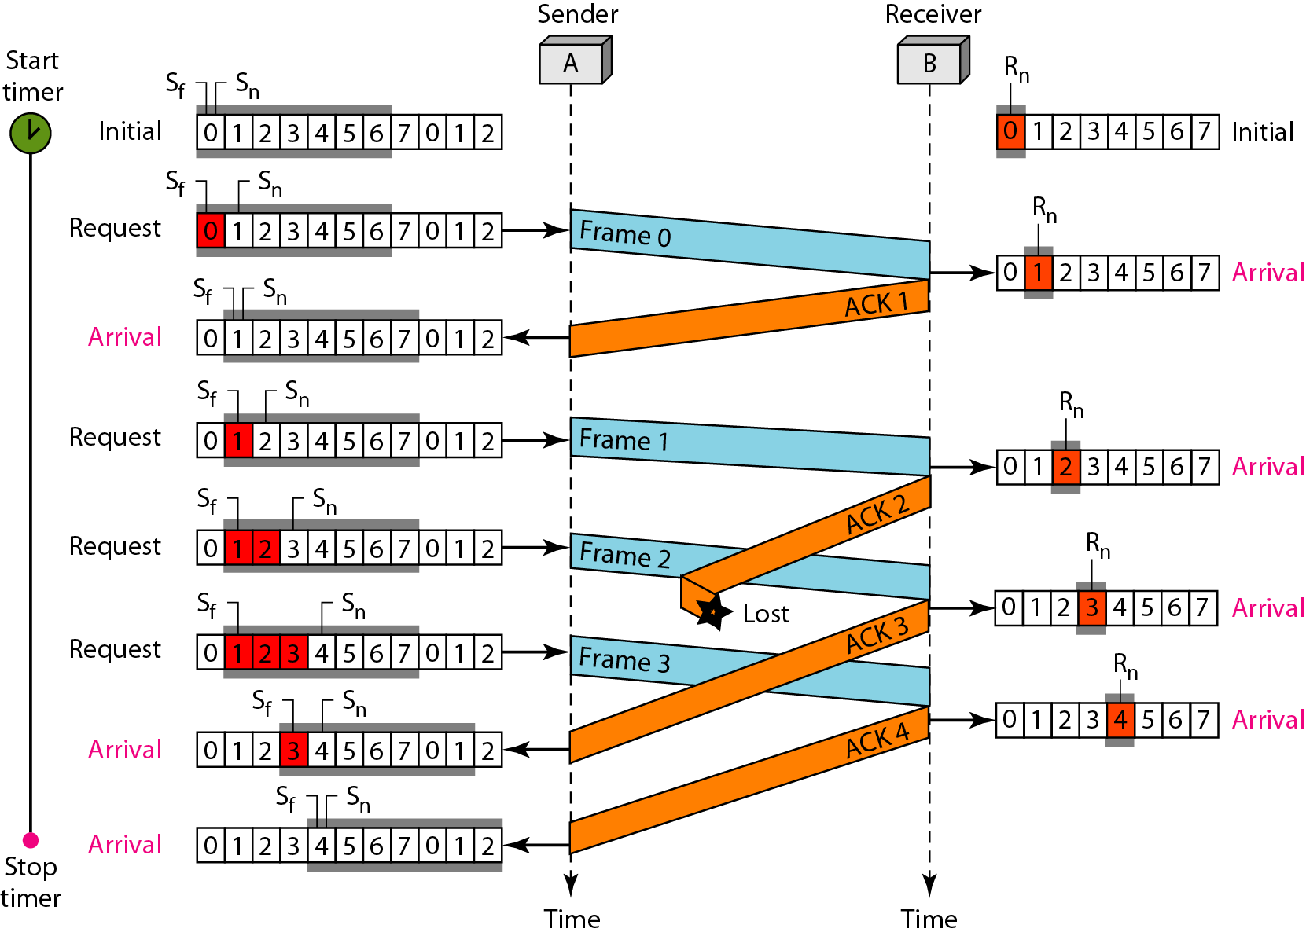
Figure 11.16 Flow diagram for Example 11.6

Slide 15
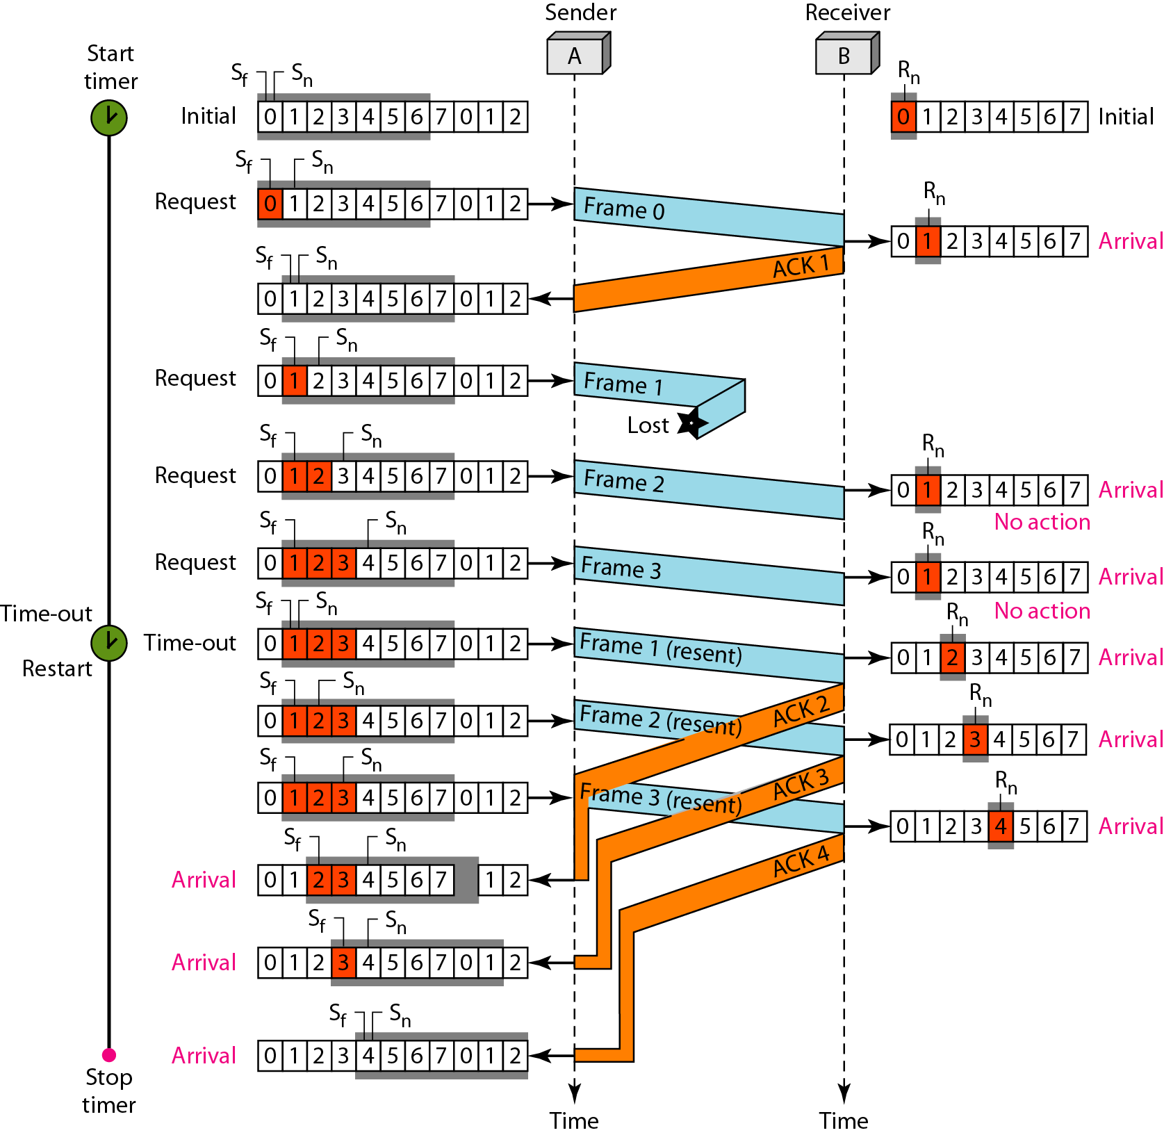
Figure 11.17 Flow diagram for Example 11.7

Slide 16
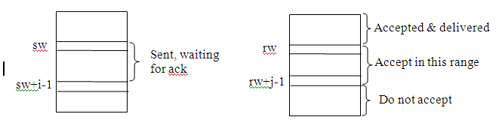
Selective repeat:
Receiver will accept frames out of order and buffer them.

Slide 17
Accept any frame in window and buffer. Deliver all received frames in consecutive slots starting with rw.
Receiver acknowledges the last frame delivered, not necessarily the last one received
Frame arrives out of order – if in window, buffer it but might send a nak for expected frame (attempt to speed things up), but not required.
Sender: frame timer expires, send only that frame

Slide 18
Window size with m-bit sequence field (assume m=3).
Sender window=4 and receiver window=5
Sender sends 0-3
Receiver gets 0-3 and advances window to 4 5 6 7 0
Receiver sends ack
Ack is lost
sender resends 0-3
Receiver accepts 0 as new.
Similar if sender window=5 and receiver window=4.

Slide 19
Sender window=4 and receiver window=4
Sender sends 0-3
Receiver gets 0-3, delivers, and advances window to 4 5 6 7
Receiver sends ack
Ack is lost
sender resends 0-3
New frames are rejected.

Slide 20
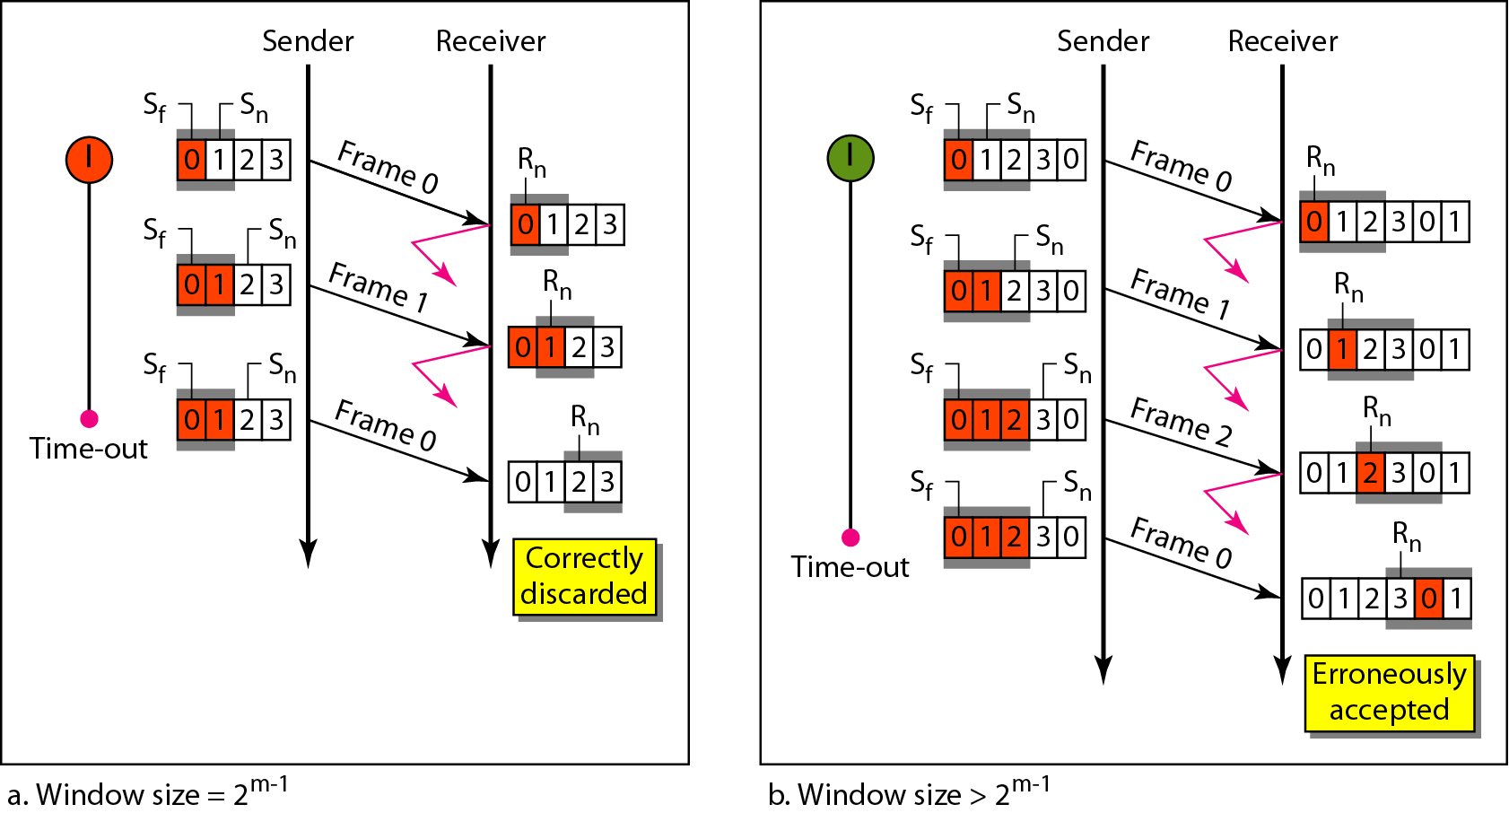
Figure 11.21 Selective Repeat ARQ, window size

Slide 21
Sender window size + receiver window size = 2^{m}.
Typically both can be 2^{m-1}.

Slide 22
Algorithm 11.10 Receiver-site Selective Repeat algorithm

Slide 23
Algorithm 11.10 Receiver-site Selective Repeat algorithm

Slide 24
Algorithm 11.9 Sender-site Selective Repeat algorithm
(continued)

Slide 25
Algorithm 11.9 Sender-site Selective Repeat algorithm
(continued)
(continued)

Slide 26
Algorithm 11.9 Sender-site Selective Repeat algorithm
(continued)

Slide 27
Do some examples

Slide 28
HDLC (High-Level Data Link Protocol): ISO standard
IBM developed SDLC (Synchronous Data Link Control Protocol), submitted it to ISO who made changes and called it HDLC.
IBM also submitted to ANSI who made changes and called it ADCCP (Advanced Data Communication Control Protocol)

Slide 29
CCITT (now ITU) adopted HDLC and modified it to become LAP (Link Access Protocol) for its X.25 networks.
IEEE created LLC (Logical Link Control-802.2) another variant on HDLC
[http://docwiki.cisco.com/wiki/Synchronous_Data_Link_Control_and_Derivatives]
[http://en.wikipedia.org/wiki/HDLC]
[http://en.wikipedia.org/wiki/Logical_Link_Control]

Slide 30

Frame format

Slide 31

Flag – bit pattern 01111110 to mark beginning and end of frame.
To prevent pattern from appearing in data, use bit stuffing. Insert a bogus “0” after five consecutive 1’s.

Slide 32
N(S) – sequence number
P/F – (request if sent by a primary device, last frame indicator if sent by a secondary device)
N(R) – acknowledgment;
S – 2-bit value indicating receive ready (ready to receive frames), REJ (like nak for go-back-n), receive not ready (stop incoming frames), SREJ (like nak for selective repeat).
Can read book for more info.

Slide 33
Will skip section 7 – Point-to-Point protocols

